Slide 1

DATABASE
TECHNOLOGIES
Relational model, Storage formats
and Indexing
Suresh Jamadagni
Department of Computer Science
and Engineering

Slide 2

DATABASE TECHNOLOGIES
Relational model, Storage formats and Indexing
Suresh Jamadagni
Department of Computer Science and Engineering

Slide 3
DATABASE TECHNOLOGIES
Relational Model – Database Design
Functional dependencies (FDs)
Are constraints that are derived from the meaning and interrelationships of the data attributes
Are used to specify formal measures of the "goodness" of relational designs
And keys are used to define normal forms for relations
A set of attributes X functionally determines a set of attributes Y if the value of X determines a unique value for Y
X  Y holds if whenever two tuples have the same value for X, they must have the same value for Y

Slide 4
DATABASE TECHNOLOGIES
Relational Model – Database Design
Functional Dependencies example:
Social security number determines employee name
SSN  ENAME
Project number determines project name and location
PNUMBER  {PNAME, PLOCATION}
Employee ssn and project number determines the hours per week that the employee works on the project
{SSN, PNUMBER}  HOURS

Slide 5
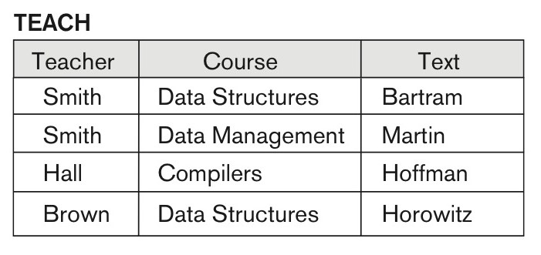
DATABASE TECHNOLOGIES
Relational Model – Database Design
Functional Dependencies example:
Given an instance of the TEACH relation, we can say that the
FD: Text → Course may exist.
However, the FDs Teacher → Course, Teacher → Text and
Course → Text are ruled out.

Slide 6
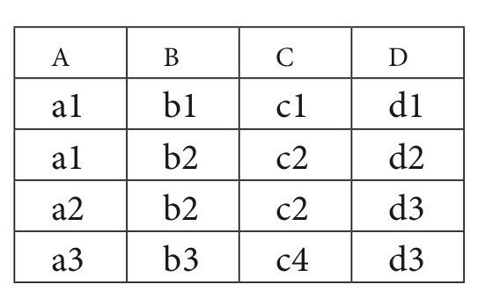
DATABASE TECHNOLOGIES
Relational Model – Database Design
Functional Dependencies example:
A relation R(A, B, C, D) with its extension.
Which FDs may exist in this relation?
FDs that may hold:
B → C;
C → B;
{A, B} → C;
{A, B} → D;
{C, D} → B.
FDs that do not hold:
A → B;
B → A;
D → C;

Slide 7
DATABASE TECHNOLOGIES
Relational Model – Database Design
Functional Dependencies – Inference rules:
Armstrong's inference rules:
IR1: (Reflexive) If Y subset-of X, then X → Y
IR2: (Augmentation) If X → Y, then XZ → YZ
(Notation: XZ stands for X U Z)
IR3: (Transitive) If X → Y and Y → Z, then X → Z
Some additional inference rules:
IR4: Decomposition or Projective: If X → YZ, then X → Y and X → Z
IR5: Union or Additive: If X → Y and X → Z, then X → YZ
IR6: Psuedotransitivity: If X → Y and WY → Z, then WX → Z

Slide 8
DATABASE TECHNOLOGIES
Relational Model – Database Design
Normalization:
Normalization process proposed by Codd takes a relation schema through a series of tests to certify whether it satisfies a certain normal form
The process is a top-down approach by evaluating each relation against the criteria for each normal form and decomposing relations if required
1 NF, 2 NF and 3 NF are based on the functional dependencies among the attributes of a relation
4th NF proposed based on multi-value dependency
5th NF proposed based on join dependencies

Slide 9
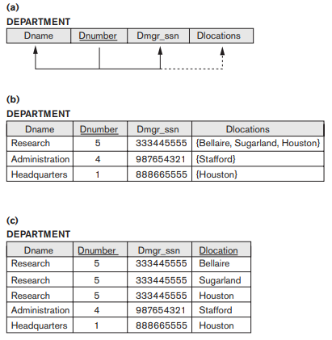
DATABASE TECHNOLOGIES
Relational Model – Database Design - Normalization
1st Normal Form:
It states that the domain of an attribute must include only atomic (simple, indivisible) values and that the value of any attribute in a tuple must be a single value from the domain of that attribute.
1NF disallows having a set of values, a tuple of values, or a combination of both as an attribute value for a single tuple

Slide 10
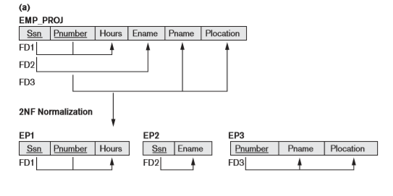
DATABASE TECHNOLOGIES
Relational Model – Database Design - Normalization
2nd Normal Form:
A relation schema R is in 2NF if every nonprime attribute A in R is fully functionally dependent on the primary key of R.
A relation schema R is in second normal form (2NF) if every nonprime attribute A in R is not partially dependent on any key of R.

Slide 11
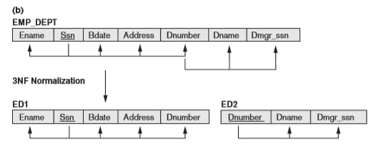
DATABASE TECHNOLOGIES
Relational Model – Database Design - Normalization
3rd Normal Form:
A relation schema R is in 3NF if it satisfies 2NF and no nonprime attribute of R is transitively dependent on the primary key.
A relation schema R is in third normal form (3NF) if, whenever a non trivial functional dependency X→A holds in R, either
X is a superkey of R or
A is a prime attribute of R

Slide 12
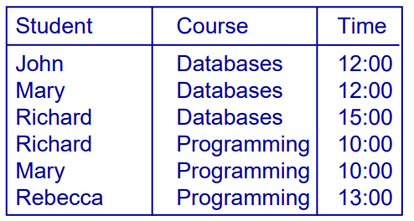
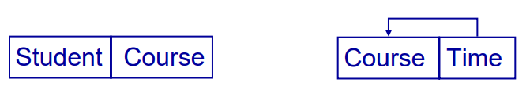
DATABASE TECHNOLOGIES
Relational Model – Database Design - Normalization
Boyce-Codd Normal Form:
A relation schema R is in BCNF if whenever a non-trivial functional dependency X→A holds in R, then X is a superkey of R.
Every relation in BCNF is also in 3NF; however, a relation in 3NF is not necessarily in BCNF
Non-trivial FDs
• {Student, Course} → {Time}
• {Time} → {Course}

Slide 13
DATABASE TECHNOLOGIES
Relational Model – Database Design - Normalization
4th Normal Form:
If no database table instance contains two or more, independent and multivalued attributes describing the relevant entity, then it is in 4th Normal Form.
Student
Student | Course | Hobby
A | DAA | Movies
A | DBMS | Movies
A | LA | Movies
A | DAA | Reading
A | DBMS | Reading
A | LA | Reading
B | DAA | Cricket
B | DBMS | Cricket
B | LA | Cricket
B | DAA | Movies
B | DBMS | Movies
B | LA | Movies
B | DAA | Music
B | DBMS | Music
B | LA | Music
Enrollment
Student | Course
A | DAA
A | DBMS
A | LA
B | DAA
B | DBMS
B | LA
Hobby
Student | Hobby
A | Movies
A | Reading
B | Cricket
B | Movies
B | Music

Slide 14
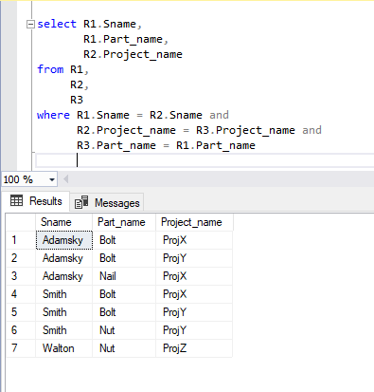
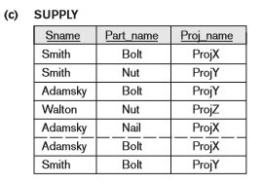
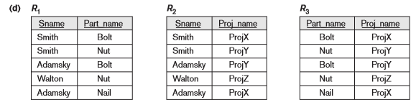
DATABASE TECHNOLOGIES
Relational Model – Database Design - Normalization
5th Normal Form:
A table is in 5th Normal Form only if it is in 4NF and it cannot be decomposed into any number of smaller tables without loss of data.

Slide 15
DATABASE TECHNOLOGIES
Relational Model – Database Design - Example
Functional Dependencies
Ssn → {Fname, Minit, Lname, Bdate, Address, Sex, Salary, Mgr_ssn, Dno}
Pnumber → {Pname, Plocation}
{Ssn, Pnumber} → Hours
Dno → {Dname, Mgr_ssn, Mgr_start_date, Dlocation, Pnumber}

Slide 16
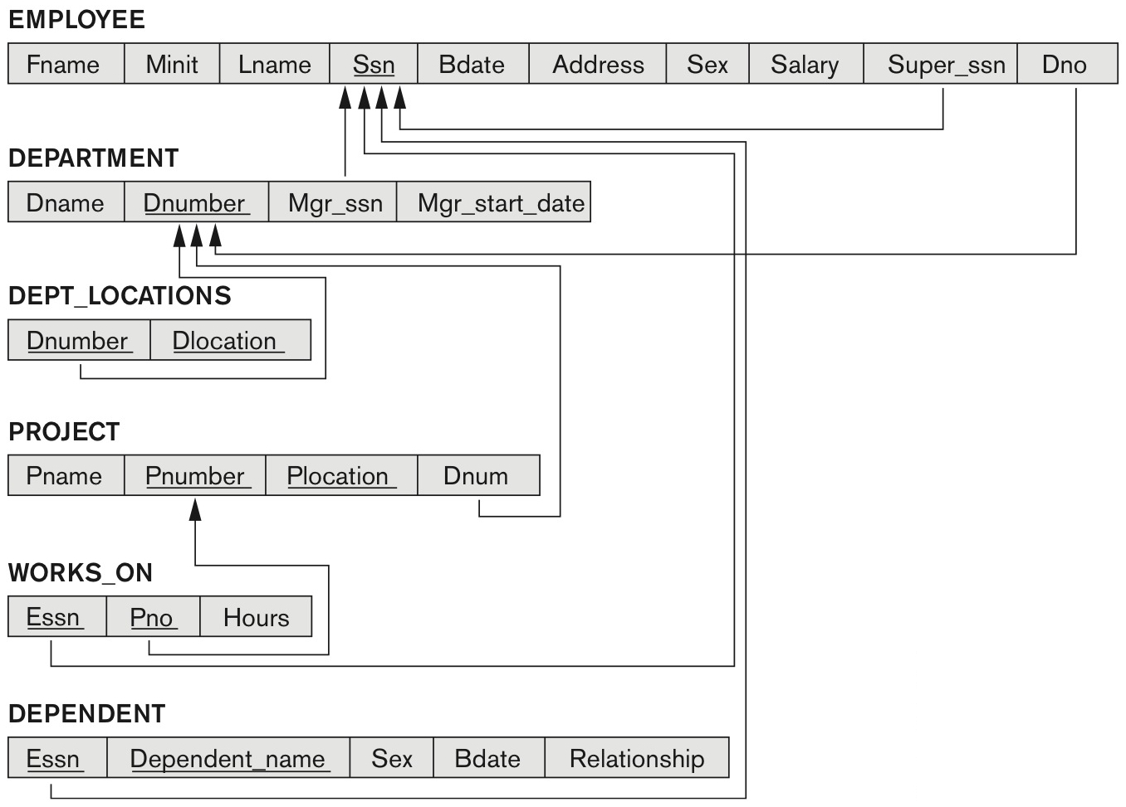
DATABASE TECHNOLOGIES
Relational Model – Database Design - Example

Slide 17
Testing for non-additive (Lossless) Join Property
Algorithm:
Input: A universal relation R, a decomposition D = {R1, R2, ..., Rm} of R, and a set F of functional dependencies.
1. Create an initial matrix S with one row i for each relation R_{i} in D, and one column j for each attribute A_{j} in R.
2. Set S(i,j) := b_{ij} for all matrix entries. (* each bij is a distinct symbol associated with indices (i,j) *).
3. For each row i representing relation schema R_{i}
{
for each column j representing attribute Aj
{
if (relation R_{i} includes attribute A_{j})
then set S(i,j):= a_{j};
};
};
(* each a_{j} is a distinct symbol associated with index (j) *)

Slide 18
Testing for non-additive (Lossless) Join Property
4. Repeat the following loop until a complete loop execution results in no changes to S
{
for each functional dependency X Y in F
{
for all rows in S which have the same symbols in the columns corresponding to attributes in X
{
make the symbols in each column that correspond to an attribute in Y be the same in all these
rows as follows:
If any of the rows has an “a” symbol for the column, set the other rows to that same “a” symbol
in the column.
If no “a” symbol exists for the attribute in any of the rows, choose one of the “b” symbols that appear in one of
the rows for the attribute and set the other rows to that same “b” symbol in the column ;
};
};
};
5. If a row is made up entirely of “a” symbols, then the decomposition has the lossless join property; otherwise it does not.

Slide 19
DATABASE TECHNOLOGIES
Relational Model – Database Design - Example

Slide 20
THANK YOU
Suresh Jamadagni
Department of Computer Science and Engineering
sureshjamadagni@pes.edu

